Slide 1
Design And Analysis of Algorithms Optimal random algorithm for finding out minimum spanning tree
2010030490-VARUN KRISHNA
2010030494-SHASHIKANTH
2010030468-SATHWIK
2010030463-ANIL KUMAR
Under the guidance of
UDAYARANI MA’AM

Slide 2
PROBLEM STATEMENT AND DOMAIN
The MST is a problem in a field of study known as Graph Theory in mathematics and computer science. Problems involving graphs come up a lot in computer science, not only related to networking problems, but also in describing more sophisticated or interconnected relationships between data and information.For example, complicated scheduling problems, logistics, or even sociology problems, or interactions between molecules. Many real-world problems can be expressed or visualized as graphs.

Slide 3
EXISTING SOLUTIONS :
Kruskal’s Algorithm :
Kruskal’s Algorithm builds the spanning tree by adding edges one by one into a growing spanning tree. Kruskal's algorithm follows greedy approach as in each iteration it finds an edge which has least weight and add it to the growing spanning tree.
In Kruskal’s algorithm, at each iteration we will select the edge with the lowest weight. So, we will start with the lowest weighted edge first i.e., the edges with weight.
Prim’s Algorithm :
Prim’s Algorithm also use Greedy approach to find the minimum spanning tree. In Prim’s Algorithm we grow the spanning tree from a starting position. Unlike an edge in Kruskal's, we add vertex to the growing spanning tree in Prim’s.
In Prim’s Algorithm, we will start with an arbitrary node (it doesn’t matter which one) and mark it. In each iteration we will mark a new vertex that is adjacent to the one that we have already marked. As a greedy algorithm, Prim’s algorithm will select the cheapest edge and mark the vertex

Slide 4
PROPOSED ALGORITHM DESIGN TECHNIQUE
Kruskal’s Algorithm :
Kruskal’s Algorithm builds the spanning tree by adding edges one by one into a growing spanning tree. Kruskal's algorithm follows greedy approach as in each iteration it finds an edge which has least weight and add it to the growing spanning tree.
Algorithm Steps:
Sort the graph edges with respect to their weights.
Start adding edges to the MST from the edge with the smallest weight until the edge of the largest weight.
Only add edges which doesn't form a cycle , edges which connect only disconnected components.

Slide 5
ALGORITHM
Step 1: Create a forest F in such a way that every vertex of the graph is a separate tree.
Step 2: Create a set E that contains all the edges of the graph.
Step 3: Repeat Steps 4 and 5 while E is NOT EMPTY and F is not spanning
Step 4: Remove an edge from E with minimum weight
Step 5: IF the edge obtained in Step 4 connects two different trees, then add it to the forest F
(for combining two trees into one tree).
ELSE
Discard the edge
Step 6: END

Slide 6
So now how to check if 2 vertices are connected or not ?
This could be done using DFS which starts from the first vertex, then check if the second vertex is visited or not. But DFS will make time complexity large as it has an order of O(V+E) where V is the number of vertices, E is the number of edges. So the best solution is "Disjoint Sets": Disjoint sets are sets whose intersection is the empty set so it means that they don't have any element in common.

Slide 7
Time Complexity:
O(ElogE) or O(ElogV). Sorting of edges takes O(ELogE) time. After sorting, we iterate through all edges and apply the find-union algorithm. The find and union operations can take at most O(LogV) time. So overall complexity is O(ELogE + ELogV) time. The value of E can be at most O(V2), so O(LogV) is O(LogE) the same. Therefore, the overall time complexity is O(ElogE) or O(ElogV)

Slide 8
DATA STRUCTURES NEEDED
GRAPH DATA STRUCTURE
Graph is a non linear data structure that has nodes and edges. Minimum Spanning Tree is a set of edges in an undirected weighted graph that connects all the vertices with no cycles and minimum total edge weight. When number of edges to vertices is high, Prim's algorithm is preferred.

Slide 9
In Kruskal’s algorithm, at each iteration we will select the edge with the lowest weight. So, we will start with the lowest weighted edge first i.e., the edges with weight 1. After that we will select the second lowest weighted edge i.e., edge with weight 2. Notice these two edges are totally disjoint. Now, the next edge will be the third lowest weighted edge i.e., edge with weight 3, which connects the two disjoint pieces of the graph. Now, we are not allowed to pick the edge with weight 4, that will create a cycle and we can’t have any cycles. So we will select the fifth lowest weighted edge i.e., edge with weight 5. Now the other two edges will create cycles so we will ignore them. In the end, we end up with a minimum spanning tree with total cost 11 ( = 1 + 2 + 3 + 5).

Slide 10
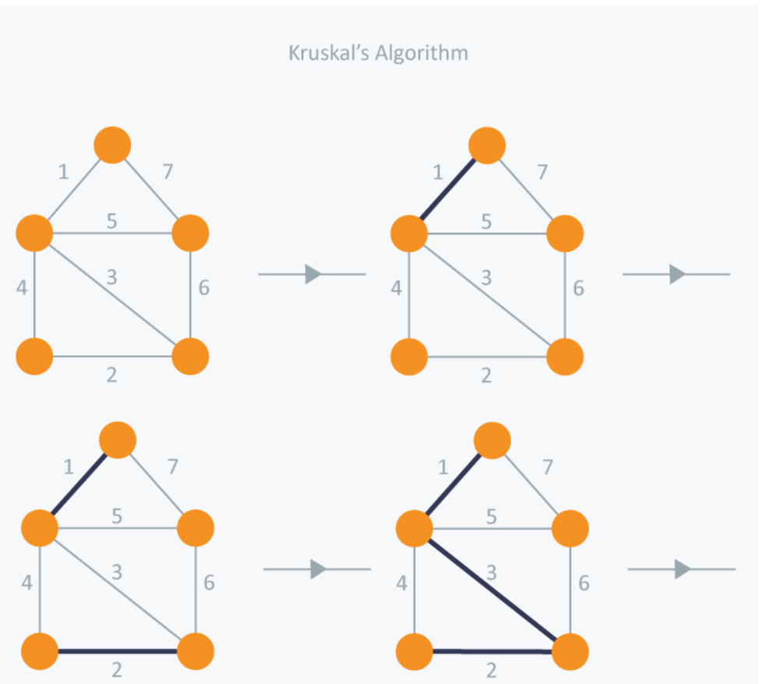
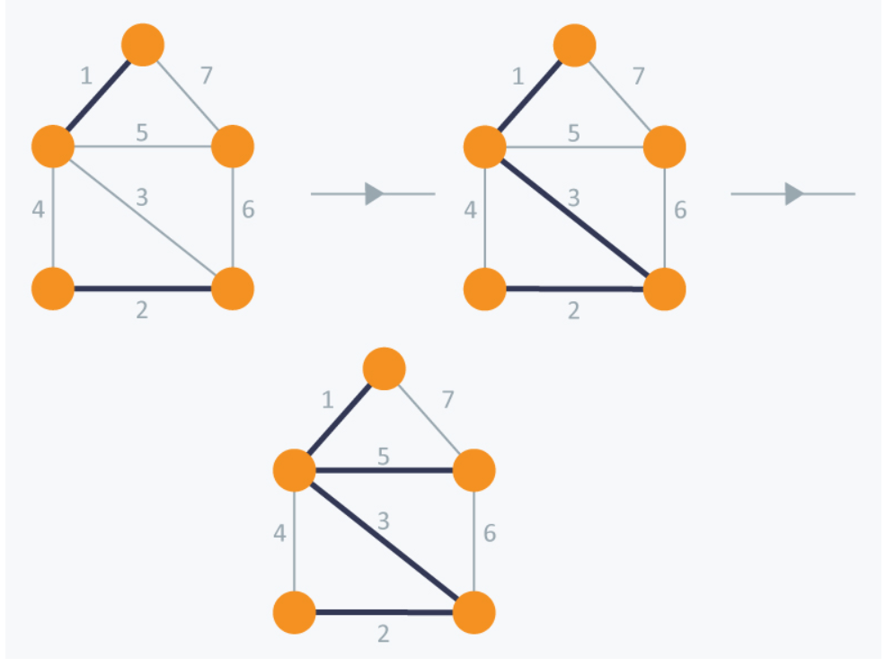

Slide 11

GITHUB SETUP

Slide 12
DIVISION OF WORK AMONG THE GROUP MEMBERS
CODING AND TESTING – ANIL KUMAR, SATWIK
ALGORITHM AND FLOWCHART - VARUN KRISHNA
ANALYZE DATA AND TECHNIQUES - SHASHIKANTH

